Slide 1
BASIC ULTRASOUND PHYSICS
KATHIRVEL SUBRAMANIAM MD MPH

Slide 2
Question 1
Increasing frequency of the transducer does all except
Improves axial resolution
Decreases wavelength
Decreases depth of penetration
Increases pulse length

Slide 3
Q 2
Propagation speed is
Determined by the density and stiffness of the medium
Determined by the source
Is 1540 m/sec in the cardiac tissue
Is 1540 km/sec in cardiac tissue

Slide 4
Q3
Temporal resolution can be improved by
Using single focus
Using narrow sector
Minimizing line density
Maximizing depth of view

Slide 5
Q4
When the angle between the sound beam and direction of motion is 90 degrees, the measured velocity is equal to
True velocity
0
20% true velocity
Peak velocity

Slide 6
Q5
In phased array transducer, beam steering and focusing is achieved by
Manually rotating the transducer
Mechanically rotating transducer
Changing resonant frequency of piezo electric crystals
Changing the timing of pulses to the piezo electric elements

Slide 7
SOUND WAVES

Slide 8
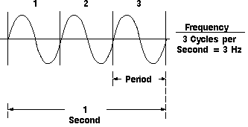
SOUND WAVES
LONGITUDINAL WAVE

Slide 9
SOUND WAVES

Slide 10
SOUND WAVES
LONGITUDINAL WAVES
COMPRESSION AND RAREFACTION
CHARACTERS (FREQUENCY, PERIOD, AMPLITUDE, WAVELENGTH, VELOCITY)

Slide 11
FREQUENCY
HUMAN EARS CAN HEAR 20 Hz to 20 KHz
FREQUENCY ABOVE 20 KHz IS CALLED ULTRASOUND
DIAGNOSTIC ULTRASOUND USED 1-20 MHz

Slide 12
VELOCITY
PROPAGATION VELOCITY
FASTEST IN BONE 3000 m/sec
SLOWEST IN LUNGS 700 m/sec
HEART, BLOOD , BLOOD VESSELS, SOFT TISSUE – 1540 m/sec

Slide 13
WAVELENGTH
WAVELENGTH = VELOCITY/FREQUENCY
= 1540 m/sec /5 MHz
= 1.54/5
= 0.308 mm

Slide 14
WAVELENGTH VS FREQUENCY
WAVELENGTH AND FREQUENCY INVERSELY RELATED
INCREASED WAVELENGTH OR DECREASE IN FREQUENCY WILL CAUSE DECREASED RESOLUTION OF AN IMAGE
BUT IMPROVE PENETRATION OF A SOUND WAVE TO IMAGE DEEPER STRUCTURES

Slide 15
PENETRATION VS RESOLUTION

Slide 16
Amplitude, Power and Intensity
Energy or acoustic pressure of an ultrasound signal
Described in Decibels
Echo-image 1-120 Decibels
Increased energy Power related to bio-effects (Temperature elevation and cavitation)

Slide 17
ULTRASOUND TISSUE INTERACTION
STIFFNESS
DENSITY
THEIR RELATION TO PROPAGATION SPEED (STIFFNESS IS DIRECTLY RELATED TO SPEED- BONE MOST STIFF)
ACOUSTIC IMPEDENCE = DENSITY MULTIPLIED BY PROPAGATION SPEED, DETERMINES THE ULTRASOUND TRANSMISSION AND REFLECTION AT TISSUE BOUNDARIES

Slide 18
US TISSUE INTERACTIONS

Slide 19
REFLECTION
RESPONSIBLE FOR IMAGE FORMATION
DEPENDS ON TWO FACTORS ACOUSTIC IMPEDENCE AND ANGLE OF REFLECTION
ULTRASOUND DROP OUTS RESULTS FROM PARALLEL ALIGNMENT BETWEEN TISSUE INTERFACE AND ULTRASOUND BEAM

Slide 21
SCATTERING
OCCURS IN MOVING BLOOD ELEMENTS SUCH AS RED BLOOD CELLS
RED CELLS ARE SMALLER IN SIZE THAN WAVELENGTH BASIS FOR SCATTERING
BASIS FOR DOPPLER ECHOCARDIOGRAPHY
SCATTERING AT TISSUES BASIS FOR TISSUE DOPPLER AND SPECKLE IMAGING

Slide 22
REFRACTION
OCCURS WHEN DEFLECTION OF SOUND WAVE OCCURS AS THEY PASS THROUGH MEDIUM WITH DIFFERENT ACOUSTIC IMPEDENCE
LENS IN FRONT OF THE TRANSDUCER USED TO FOCUS PRODUCES PLANNED REFRACTION
UNPLANNED REFRACTION RESPONSIBLE FOR ARTIFACTS OR DOUBLE IMAGES

Slide 23
ATTENUATION
ATTENUATION DETERMINES PENETRATION DEPTH
FREQUENCY AND WAVELENGTH RELATED
1 MHz probe – US PENETRATION DEPTH 30 cm 5MHz probe - US PENETRATION DEPTH 6 CM

Slide 24
TRANSDUCER

Slide 25
COMPONENTS
PIEZO ELECTRIC CRYSTAL (LEAD ZIRCONATE TITANATE)
CRYSTALS COMPRESS AND EXPAND
TRANSMITTER AND RECEIVER FUNCTIONS
BACKING OR DAMPING MATERIAL (REDUCES RINGING OF CRYSTALS TO PRODUCE SHORT PULSE LENGTH TO IMPROVE SPATIAL RESOLUTION)
MATCHING LAYER- IMPROVES TRANSMISSION OF US BETWEEN PZT AND TISSUE SURFACE
LENS- FOCUS

Slide 26
TYPES OF TRANSDUCERS
LINEAR ARRAY (7-12 MHz); VASCULAR ACCESS
PHASED ARRAY (2-4 MHz); CARDIAC
CURVILINEAR ARRAY (2-6 MHz); ABDOMINAL

Slide 27
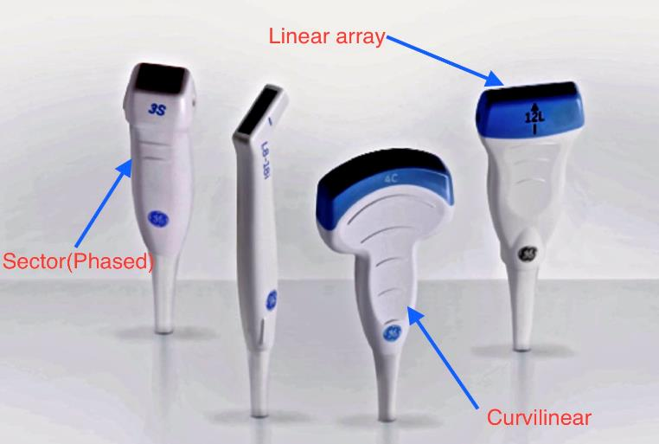

Slide 28
PULSED ULTRASOUND

Slide 29
DIAGNOSTIC ULTRASOUND
PULSED ULTRASOUND
PULSE DURATION, PULSE LENGTH
PULSE REPITION PERIOD AND PULSE REPITION FREQUENCY
DUTY FACTOR = PULSE DURATION / PRP X 100
1% 2D ECHO, 5% PWD AND 100% CWD

Slide 30
RESOLUTION
SPATIAL (AXIAL, LATERAL AND ELEVATIONAL)
TEMPORAL

Slide 31
AXIAL RESOLUTION
DEPENDS ON
SPATIAL PULSE LENGTH

Slide 32
IMAGE RESOLUTION

Slide 33
LATERAL AND ELEVATIONAL RESOLUTION
BEAM WIDTH (FOCUS) AT EACH DEPTH IS THE MAJOR DETERMINANT

Slide 34
FOCAL ZONE
NEAR ZONE
FOCAL ZONE
FAR ZONE

Slide 35
FOCAL ZONE

Slide 36
LATERAL RESOLUTION

Slide 37
TEMPORAL RESOLUTION
FRAME RATE- FRAMES PER SECOND
INCREASED FRAME RATE- INCREASED ABILITY TO APPRECIATE RAPIDLY CHANGING EVENTS
HIGHER FRAME RATE HIGHER TEMPORAL RESOLUTION

Slide 38
TEMPORAL RESOLUTION

Slide 39
TEMPORAL RESOLUTION

Slide 40
ULTRASOUND MODALITIES
TWO DIMENSIONAL ECHOCARDIOGRAPHY
M MODE
THREE DIMENSIONAL ECHOCARDIOGRAPHY
DOPPLER ECHOCARDIOGRAPHY (COLOR AND SPECTRAL DOPPLER) SPECTRAL- PULSE WAVE AND CONTINUOUS WAVE

Slide 41
M -MODE
MOTION MODE
MOTION VERSUS TIME AND DEPTH
HIGH SAMPLING RATE AND TEMPORAL RESOLUTION
USED TO EVALUATE RAPIDLY MOVING STRUCTURES

Slide 42
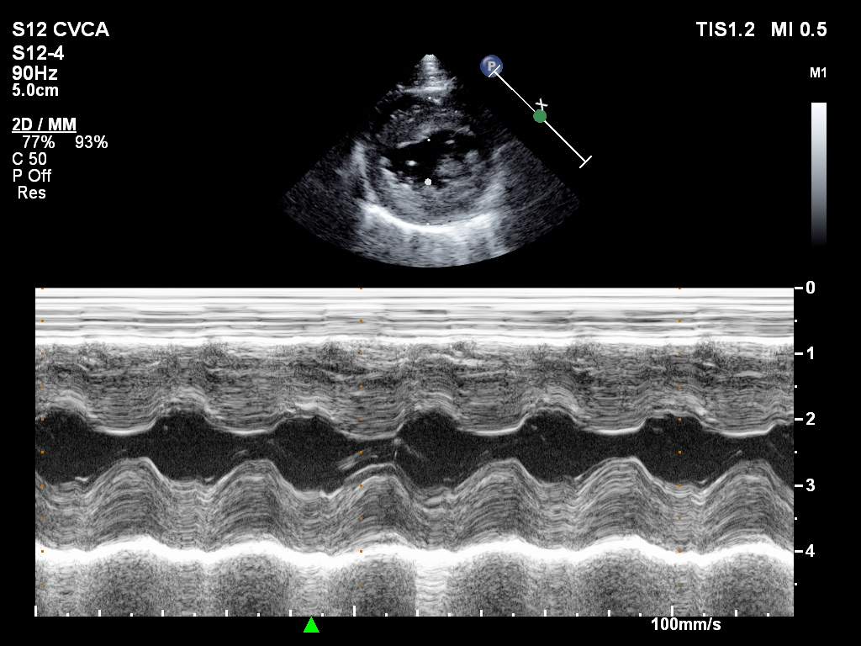
M-MODE LV

Slide 43
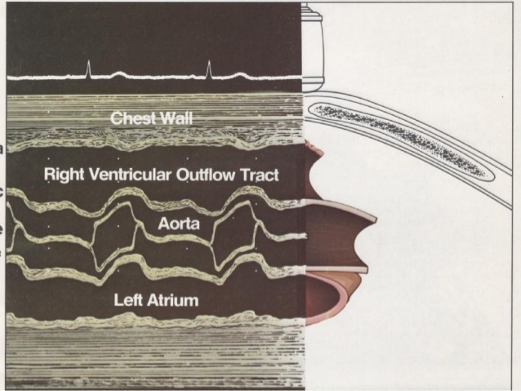
M MODE AV

Slide 44
Doppler Principle
Change in frequency of transmitted ultrasound signal by backscattering from small moving structures such as Red blood cells intercepted by the ultrasound beam
Frequency shift is higher if the red cells are moving towards the transducer (Positive doppler effect)
Frequency shift is lower if the red cells are moving away from the transducer (Negative Doppler effect)
Doppler ultrasound is audible ( 0-20 KHz)

Slide 45
Doppler effect

Slide 46
Doppler equation
Blood flow Velocity from Doppler equation
= c (F_{S}-F_{T})/ 2F_{T} (Cosθ)
C = Speed of sound
Fs= Scattered frequency
Ft= Transmitted frequency
Θ= Angle between blood flow and ultrasound beam

Slide 47
Spectral analysis
Backscattering contains multiple frequencies
Analysis of frequencies done FFT
Direction, velocity and amplitude

Slide 48
CW Doppler
All velocities in the path analyzed
FULL envelope
High velocities analyzed
Range Ambiguity; Inability to locate the site of high velocity
No Aliasing

Slide 49
Pulse wave Doppler
Only the velocity in the selected location is analyzed
HOLLOW Appearance
No Range ambiguity
Susceptible to aliasing
Not the Doppler modality to analyze the highest velocity

Slide 50
Nyquist limit
Maximum detectable frequency shift
If velocity exceeds, cuts above baseline at the top
Use CWD
Shift baseline
Low frequency transducer
High PRF Doppler, Increase PRF for the depth (NL= PRF/2)

Slide 51
COLOR FLOW DOPPLER
Pulse wave Doppler
Multiple scan lines and multiple gates of sampling
Frame rate and temporal resolution are important issues with CFD!
Direction of flow, Magnitude and quality of flow

Slide 52
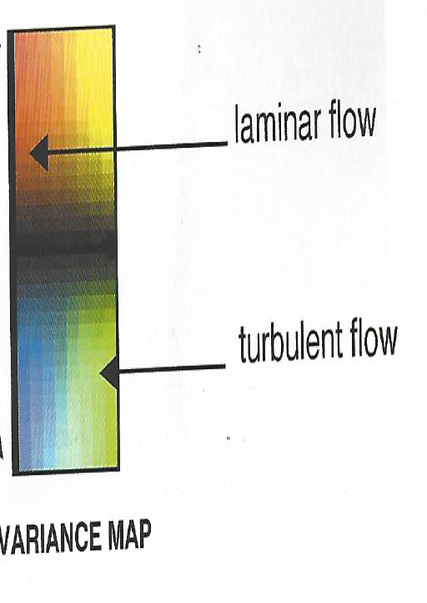
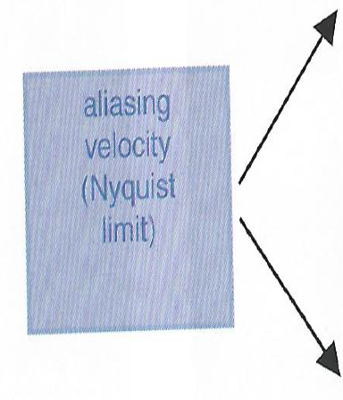
Velocity map versus Variance map

Slide 53
Laminar vs Turbulence

