Slide 1
Coagulation imbalance in multivisceral transplantation
Moderator: Dr. Ramona Nicolau-Raducu, University of Miami / Miami Transplant institute
Presenter: Dr. Yehuda Raveh, University of Miami / Miami Transplant institute,
Panelists:
Dr. Raymond Planinsic, University of Pittsburgh Medical Center, Pittsburgh, PA
Dr. Lorenzo De Marchi, Georgetown University Medical Center, Washington, DC
Dr. Samuel DeMaria, Jr., Mt. Sinai, NY, NY
Disclosure: none

Slide 2
Learning Objectives
Review the type of and indications for visceral transplantation
Preoperative work up
Discuss abnormal coagulation during visceral transplantation: clinical presentation, diagnosis, and management

Slide 3
Stem Case and Key Questions

Slide 4
The patient is a 59 year-old male with a >40 years h/o Crohn’s disease. Status post total proctocolectomy with end ileostomy since the 70’s, and multiple (>16) small bowel surgeries in recent years.
ESLD due to NASH, complicated by hepatic encephalopathy, upper GI bleeds, ascites, portal hypertensive gastropathy and 4 cm non-occlusive portal vein thrombosis.
The patient had right portocaval shunt.

Slide 5
Q1. What are the main types of visceral transplants, and what makes this patient a candidate for MVT?

Slide 6
The patient is a 59 year-old male with a >40 years h/o Crohn’s disease. Status post total proctocolectomy with end ileostomy since the 70’s, and multiple (>16) small bowel surgeries in recent years.
ESLD due to NASH, complicated by hepatic encephalopathy, upper GI bleeds, ascites, portal hypertensive gastropathy and 4 cm non-occlusive portal vein thrombosis.
The patient had right portocaval shunt.

Slide 7
Past medical history significant for ankylosing spondylitis, cholelithiasis, nephrolithiasis and gout.
Laboratory results show Na-140, K-3.6, Creatinine 0.6, total Bil-2.3, PT-15, INR 1.3, and Platelets-62.
Echocardiography shows normal biventricular systolic function and PA pressure, and absence of stress-induced ischemia.
The Patient was listed for multivisceral transplant with a MELD score of 11-15

Slide 8
Q2. Is preoperative laboratory workup for hypercoagulable state indicated?

Slide 9
The patient is a 59 year-old male with a >40 years h/o Crohn’s disease. Status post total proctocolectomy with end ileostomy since the 70’s, and multiple (>16) small bowel surgeries in recent years.
ESLD due to NASH, complicated by hepatic encephalopathy, upper GI bleeds, ascites, portal hypertensive gastropathy and 4 cm non-occlusive portal vein thrombosis.
The patient had right portocaval shunt.
Past medical history significant for ankylosing spondylitis, cholelithiasis, nephrolithiasis and gout.
Laboratory results show Na-140, K-3.6, Creatinine 0.6, total Bil-2.3, PT-15, INR 1.3, and Platelets-62.
Echocardiography shows normal biventricular systolic function and PA pressure, and absence of stress-induced ischemia.
The Patient was listed for multivisceral transplant with a MELD score of 11-15

Slide 10
Thrombophilia workup showed:
Antithrombin Activity 52 (L) (80 - 117)
Antithrombin Antigen 48 (L) (78 - 122)
Protein S Activity 53 (L) (62 - 148)
Protein S Total 57 (L) (89 - 167)
Protein C Antigen 31 (L) (59 - 187)
MTHFR Mutation - normal variant
Prothrombin 20210 negative
Factor V Leiden - negative
Lupus anticoagulant -negative
Silica Clotting Test Ratio 0.84 ( - <1.17)
DRVV (Lac) Ratio 0.72 ( - <1.20)

Slide 11
Q3. What is your interpretation of these results, and would it impact your intraoperative management?

Slide 12
Thrombophilia workup showed:
Antithrombin Activity 52 (L) (80 - 117)
Antithrombin Antigen 48 (L) (78 - 122)
Protein S Activity 53 (L) (62 - 148)
Protein S Total 57 (L) (89 - 167)
Protein C Antigen 31 (L) (59 - 187)
MTHFR Mutation - normal variant
Prothrombin 20210 negative
Factor V Leiden - negative
Lupus anticoagulant -negative
Silica Clotting Test Ratio 0.84 ( - <1.17)
DRVV (Lac) Ratio 0.72 ( - <1.20)

Slide 13
Q4. Any special venous access workup for TPN-dependent recipients?
What do you do if multiple occlusions are found?
Notes:
Short gut syndrome is one of the main indication for visceral transplant. These recipients receive prolonged TPN via multiple central venous access lines.

Slide 14
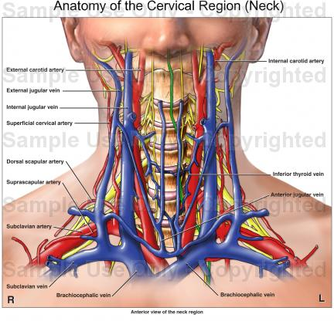

Slide 15
Our patient was not on TPN and US UE/LE showed no thrombosis.
A 45 yo F donor became available.
General anesthesia was maintained with isoflurane, midazolam, fentanyl and rocuronium.
A 9 Fr. MAC PA introducer and 12 F triple lumen venous catheters were placed in the right jugular vein. Two 20 G cannulas were placed in radial arteries.

Slide 16
Post induction labs:
PLTS 87; INR 1.3; APTT 36.7; Fib 158; Hct/Hgb 35/11.4
R-12.7, K-4, Angle 40, MA-49 , LY30-0.7

Slide 17
Q5. What coagulation abnormalities are expected in the first (exenteration) stage of MVT? Would you treat them prophylactically?
Notes:
Dissection underwent uneventful

Slide 18
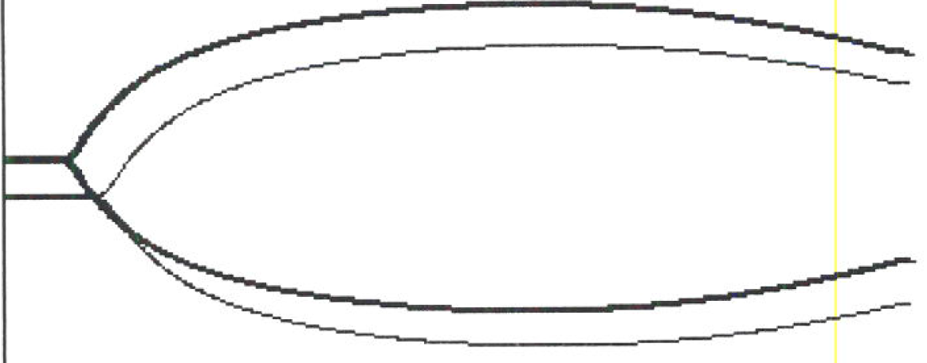
Incision to organs out 2h 6 min
Transfusion: PRBC 16; FFP 11
10 min after organs out:
PLTS 62; INR 1.46; APTT 51.5; Fib 158; Hct/Hgb 31.6/10.3
R 7.5/5, K-4.2/4.2, angle 49/52, MA 40/41, LY30 2.5/4
Notes:
Late fibrinolysis and the r time shortening to normal

Slide 19
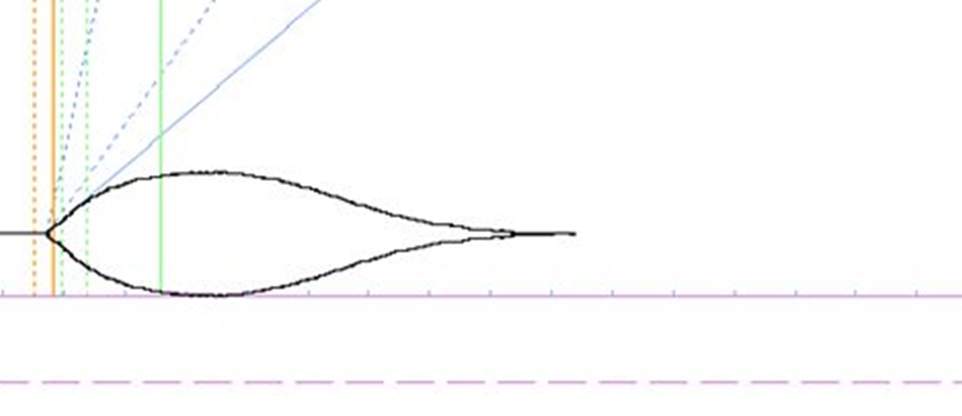
1 h after organ out moderate bleeding: PLTS 26; INR 1.79; aPTT 59, Fib 92; Hct/Hgb 31/10.2.
Organs out to reperfusion: 1 h 31 min. Warm ischemia time 40 min; CIT 476 min. Transfusion: PRBC 8; FFP 7; PLTS 3
R 7.2, K 5.4, angle 43, MA 37, LY30 17%
Notes:
Organs out until reperfusion usually is 1 h …took a little bit longer because of high K

Slide 20
Q6. What is the cause of the enhanced fibrinolysis during stage II, and how would you treat it?

Slide 21
Just prior to reperfusion, the graft was flushed with 500 ml of recipient blood (warm flush).

Slide 22
Q7. How does graft reperfusion after MVT differ from reperfusion after OLT?

Slide 23
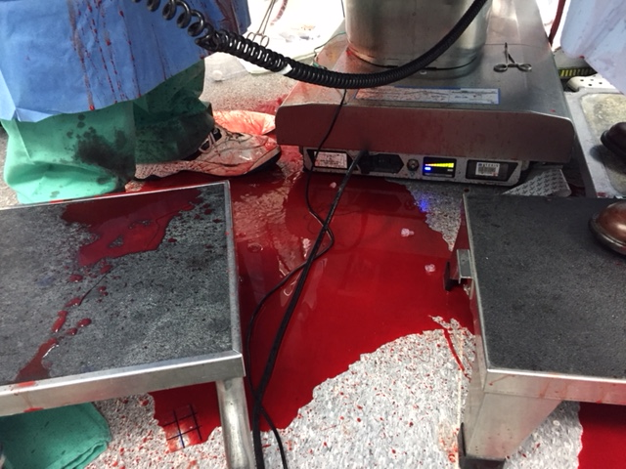
Within 30 min diffuse bleeding with hemodynamic instability requiring multiple RBC/FFP/PLTS/CRYO and vasopressors.
Surgeons complain of lack of clots in the field

Slide 24
TEG taken 10 min after reperfusion:
R 3.4/2.7; K 1.5/1.2/ angle 68.6/71.8/ MA 51.4/53.5, LY30 62.5/49

Slide 25
Q 8. What’s your diagnosis? How do you treat it?

Slide 26
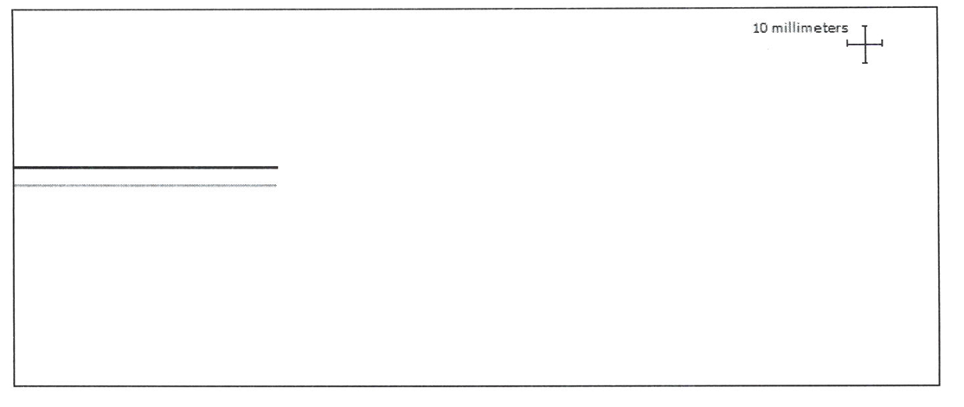
Q 9. What is the cause of severe hemorrhage with flat lines TEG?
How should it be treated?

Slide 27
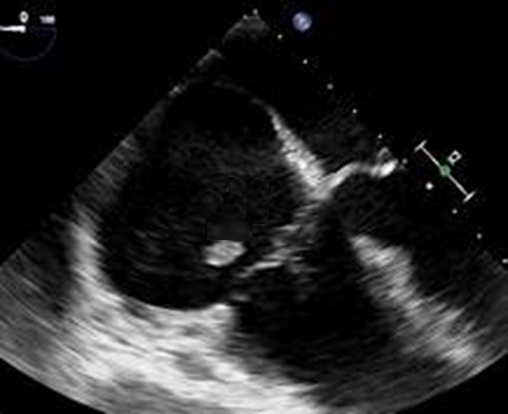
While managing the hemorrhage, a clot is observed in the right atrium

Slide 28
Q 10. How often do you see intracardiac clot in MVT? how do you treat it?

Slide 29
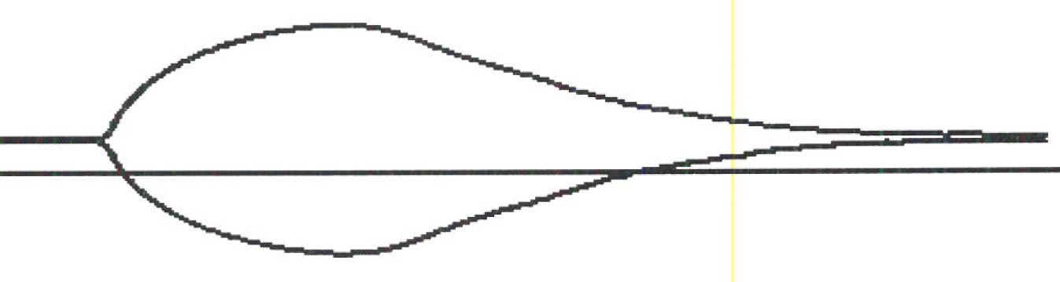
Heparin 3000 u was given, 10 min post-heparin Plts 44; INR 1.59; aPTT >200; Fbg 146; Hct/Hgb 28.8/9.4.
RV clot disappeared.
R 155/9.2; K --/4.2; angle --/46.2; MA --/35.3, LY30 --/37.8
Amicar 5 g x 2 + 1 g/h infusion given

Slide 30
Q 11. Is pretreatment with heparin indicated prior to antifibrinolytics?

Slide 31
R 10.2/7.2; K 4.3/4.2; angle 43.5/45.4; MA 42.9/44.7
After 1 h, major improvement in hemostasis.
Plts 44; INR 1.44; aPTT 85.9; Fbg 122; Hct/Hgb 26.2/8.7

Slide 32
Reperfusion to end of surgery: 4h 50 min
Total surgical time 9h
Total blood products given after reperfusion: RBC 34; FFP 30; PLTS 4; Cryo 5
Labs: PLTS: 70; INR 1.41; PTT 45.2; Fbg 235; Hct/Hgb 25.5/8.7
TEG showed R 7.3/5.4; K1.3/1.2 ; Angle 68.6/72; MA 62/70.8
Extubated day 4
Hospital stay: 47 days

Slide 33
Thank you

Slide 34
Heparin 30 units/kg
± 1000 units/hour up to reperfusion
Goal TEG: Kaolin/Heparinase
R time Ratio>2
DIC-like pattern with Diffuse Hemorrhage
Epsilon Aminocaproic Acid
5g ± 1g/hour
Oozing
TEG: Fibrinolysis LY30 ≥7.5%
Hypercoagulability/Portal vein thrombosis
Oozing
Oozing
TEG: Angle < 47º
TEG: Maximum Amplitude < 54 mm
Cryoprecipitate/Platelets
>30 min after reperfusion
Protamine 10-20 mg
TEG: Kaolin/Heparinase R time Ratio > 2

Slide 35
Transplant Proc. 2016 Mar;48(2):468-72.
Adult Intestinal and Multivisceral Transplantation: Experience From a Single Center in the United Kingdom.
Rutter CS, Amin I, Russell NK, Sharkey LM, Butler AJ, Middleton SJ.
29% 1-year mortality in MVT recipients.
”on-table bleeding” was responsible for 14% of mortality in MVT.
Thrombosis was among the causes of early mortality .
“A significant complication in patients with extensive PMVT is portal hypertension and bleeding. …..patients with extensive PMVT show both bleeding and prothrombotic tendencies perioperatively, with bleeding in the abdominal cavity and concomitant thrombosis within continuous veno-veno hemodialysis (CVVHD) lines and pulmonary emboli/intracardiac thrombosis”.
Dr. Rutter agrees that thromboembolism was a likely cause of intraoperative death (personal communication).

